Slide 1
Quick Sort

Slide 2
Introduction
Fastest known sorting algorithm in practice
Average case: O(N log N)
Worst case: O(N²)
But, the worst case seldom happens.
Another divide-and-conquer recursive algorithm, like MergeSort

Slide 3
Quicksort
S
Divide step:
Pick any element (pivot) v in S
Partition S – {v} into two disjoint groups
S1 = {x ∈ S – {v} | x <= v}
S2 = {x ∈ S – {v} | x > v}
Conquer step: recursively sort S1 and S2, (applysing QuickSort)
Combine step: the sorted S1 (by the time returned from recursion), followed by v, followed by the sorted S2 (i.e., nothing extra needs to be done)
v
v
S1
S2

Slide 4
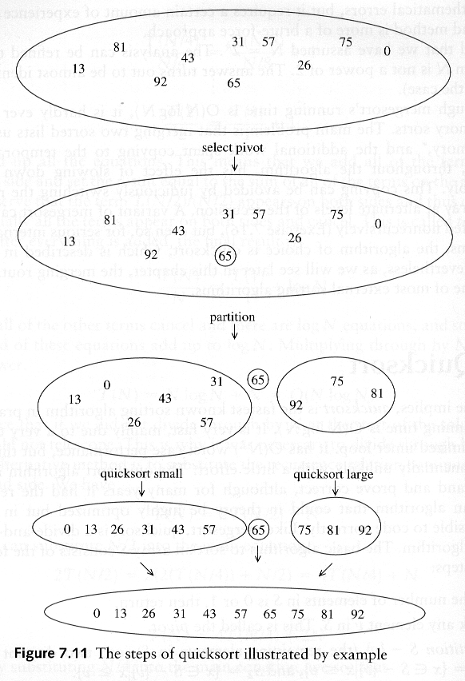
Example

Slide 6
Example
We are given array of n integers to sort:
40
20
10
80
60
50
7
30
100

Slide 7
Pick Pivot Element
There are a number of ways to pick the pivot element. In this example, we will use the first element in the array:
40
20
10
80
60
50
7
30
100

Slide 8
Partitioning Array
Given a pivot, partition the elements of the array such that the resulting array consists of:
One sub-array that contains elements >= pivot
Another sub-array that contains elements < pivot
The sub-arrays are stored in the original data array.
Partitioning loops through, swapping elements below/above pivot.

Slide 9
pivot_index = 0
40
20
10
80
60
50
7
30
100
[0] [1] [2] [3] [4] [5] [6] [7] [8]
too_big_index
too_small_index

Slide 10
While data[too_big_index] <= data[pivot]
++too_big_index
pivot_index = 0
40
20
10
80
60
50
7
30
100
[0] [1] [2] [3] [4] [5] [6] [7] [8]
too_big_index
too_small_index

Slide 11
While data[too_big_index] <= data[pivot]
++too_big_index
pivot_index = 0
40
20
10
80
60
50
7
30
100
[0] [1] [2] [3] [4] [5] [6] [7] [8]
too_big_index
too_small_index

Slide 12
While data[too_big_index] <= data[pivot]
++too_big_index
pivot_index = 0
40
20
10
80
60
50
7
30
100
[0] [1] [2] [3] [4] [5] [6] [7] [8]
too_big_index
too_small_index

Slide 13
While data[too_big_index] <= data[pivot]
++too_big_index
While data[too_small_index] > data[pivot]
--too_small_index
pivot_index = 0
40
20
10
80
60
50
7
30
100
[0] [1] [2] [3] [4] [5] [6] [7] [8]
too_big_index
too_small_index

Slide 14
While data[too_big_index] <= data[pivot]
++too_big_index
While data[too_small_index] > data[pivot]
--too_small_index
pivot_index = 0
40
20
10
80
60
50
7
30
100
[0] [1] [2] [3] [4] [5] [6] [7] [8]
too_big_index
too_small_index

Slide 15
While data[too_big_index] <= data[pivot]
++too_big_index
While data[too_small_index] > data[pivot]
--too_small_index
If too_big_index < too_small_index
swap data[too_big_index] and data[too_small_index]
pivot_index = 0
40
20
10
80
60
50
7
30
100
[0] [1] [2] [3] [4] [5] [6] [7] [8]
too_big_index
too_small_index

Slide 16
While data[too_big_index] <= data[pivot]
++too_big_index
While data[too_small_index] > data[pivot]
--too_small_index
If too_big_index < too_small_index
swap data[too_big_index] and data[too_small_index]
pivot_index = 0
40
20
10
30
60
50
7
80
100
[0] [1] [2] [3] [4] [5] [6] [7] [8]
too_big_index
too_small_index

Slide 17
While data[too_big_index] <= data[pivot]
++too_big_index
While data[too_small_index] > data[pivot]
--too_small_index
If too_big_index < too_small_index
swap data[too_big_index] and data[too_small_index]
While too_small_index > too_big_index, go to 1.
pivot_index = 0
40
20
10
30
60
50
7
80
100
[0] [1] [2] [3] [4] [5] [6] [7] [8]
too_big_index
too_small_index

Slide 18
While data[too_big_index] <= data[pivot]
++too_big_index
While data[too_small_index] > data[pivot]
--too_small_index
If too_big_index < too_small_index
swap data[too_big_index] and data[too_small_index]
While too_small_index > too_big_index, go to 1.
pivot_index = 0
40
20
10
30
60
50
7
80
100
[0] [1] [2] [3] [4] [5] [6] [7] [8]
too_big_index
too_small_index

Slide 19
While data[too_big_index] <= data[pivot]
++too_big_index
While data[too_small_index] > data[pivot]
--too_small_index
If too_big_index < too_small_index
swap data[too_big_index] and data[too_small_index]
While too_small_index > too_big_index, go to 1.
pivot_index = 0
40
20
10
30
60
50
7
80
100
[0] [1] [2] [3] [4] [5] [6] [7] [8]
too_big_index
too_small_index

Slide 20
While data[too_big_index] <= data[pivot]
++too_big_index
While data[too_small_index] > data[pivot]
--too_small_index
If too_big_index < too_small_index
swap data[too_big_index] and data[too_small_index]
While too_small_index > too_big_index, go to 1.
pivot_index = 0
40
20
10
30
60
50
7
80
100
[0] [1] [2] [3] [4] [5] [6] [7] [8]
too_big_index
too_small_index

Slide 21
While data[too_big_index] <= data[pivot]
++too_big_index
While data[too_small_index] > data[pivot]
--too_small_index
If too_big_index < too_small_index
swap data[too_big_index] and data[too_small_index]
While too_small_index > too_big_index, go to 1.
pivot_index = 0
40
20
10
30
60
50
7
80
100
[0] [1] [2] [3] [4] [5] [6] [7] [8]
too_big_index
too_small_index

Slide 22
While data[too_big_index] <= data[pivot]
++too_big_index
While data[too_small_index] > data[pivot]
--too_small_index
If too_big_index < too_small_index
swap data[too_big_index] and data[too_small_index]
While too_small_index > too_big_index, go to 1.
pivot_index = 0
40
20
10
30
60
50
7
80
100
[0] [1] [2] [3] [4] [5] [6] [7] [8]
too_big_index
too_small_index

Slide 23
While data[too_big_index] <= data[pivot]
++too_big_index
While data[too_small_index] > data[pivot]
--too_small_index
If too_big_index < too_small_index
swap data[too_big_index] and data[too_small_index]
While too_small_index > too_big_index, go to 1.
pivot_index = 0
40
20
10
30
7
50
60
80
100
[0] [1] [2] [3] [4] [5] [6] [7] [8]
too_big_index
too_small_index

Slide 24
While data[too_big_index] <= data[pivot]
++too_big_index
While data[too_small_index] > data[pivot]
--too_small_index
If too_big_index < too_small_index
swap data[too_big_index] and data[too_small_index]
While too_small_index > too_big_index, go to 1.
pivot_index = 0
40
20
10
30
7
50
60
80
100
[0] [1] [2] [3] [4] [5] [6] [7] [8]
too_big_index
too_small_index

Slide 25
While data[too_big_index] <= data[pivot]
++too_big_index
While data[too_small_index] > data[pivot]
--too_small_index
If too_big_index < too_small_index
swap data[too_big_index] and data[too_small_index]
While too_small_index > too_big_index, go to 1.
pivot_index = 0
40
20
10
30
7
50
60
80
100
[0] [1] [2] [3] [4] [5] [6] [7] [8]
too_big_index
too_small_index

Slide 26
While data[too_big_index] <= data[pivot]
++too_big_index
While data[too_small_index] > data[pivot]
--too_small_index
If too_big_index < too_small_index
swap data[too_big_index] and data[too_small_index]
While too_small_index > too_big_index, go to 1.
pivot_index = 0
40
20
10
30
7
50
60
80
100
[0] [1] [2] [3] [4] [5] [6] [7] [8]
too_big_index
too_small_index

Slide 27
While data[too_big_index] <= data[pivot]
++too_big_index
While data[too_small_index] > data[pivot]
--too_small_index
If too_big_index < too_small_index
swap data[too_big_index] and data[too_small_index]
While too_small_index > too_big_index, go to 1.
pivot_index = 0
40
20
10
30
7
50
60
80
100
[0] [1] [2] [3] [4] [5] [6] [7] [8]
too_big_index
too_small_index

Slide 28
While data[too_big_index] <= data[pivot]
++too_big_index
While data[too_small_index] > data[pivot]
--too_small_index
If too_big_index < too_small_index
swap data[too_big_index] and data[too_small_index]
While too_small_index > too_big_index, go to 1.
pivot_index = 0
40
20
10
30
7
50
60
80
100
[0] [1] [2] [3] [4] [5] [6] [7] [8]
too_big_index
too_small_index

Slide 29
While data[too_big_index] <= data[pivot]
++too_big_index
While data[too_small_index] > data[pivot]
--too_small_index
If too_big_index < too_small_index
swap data[too_big_index] and data[too_small_index]
While too_small_index > too_big_index, go to 1.
pivot_index = 0
40
20
10
30
7
50
60
80
100
[0] [1] [2] [3] [4] [5] [6] [7] [8]
too_big_index
too_small_index

Slide 30
While data[too_big_index] <= data[pivot]
++too_big_index
While data[too_small_index] > data[pivot]
--too_small_index
If too_big_index < too_small_index
swap data[too_big_index] and data[too_small_index]
While too_small_index > too_big_index, go to 1.
pivot_index = 0
40
20
10
30
7
50
60
80
100
[0] [1] [2] [3] [4] [5] [6] [7] [8]
too_big_index
too_small_index

Slide 31
While data[too_big_index] <= data[pivot]
++too_big_index
While data[too_small_index] > data[pivot]
--too_small_index
If too_big_index < too_small_index
swap data[too_big_index] and data[too_small_index]
While too_small_index > too_big_index, go to 1.
pivot_index = 0
40
20
10
30
7
50
60
80
100
[0] [1] [2] [3] [4] [5] [6] [7] [8]
too_big_index
too_small_index

Slide 32
While data[too_big_index] <= data[pivot]
++too_big_index
While data[too_small_index] > data[pivot]
--too_small_index
If too_big_index < too_small_index
swap data[too_big_index] and data[too_small_index]
While too_small_index > too_big_index, go to 1.
Swap data[too_small_index] and data[pivot_index]
pivot_index = 0
40
20
10
30
7
50
60
80
100
[0] [1] [2] [3] [4] [5] [6] [7] [8]
too_big_index
too_small_index

Slide 33
While data[too_big_index] <= data[pivot]
++too_big_index
While data[too_small_index] > data[pivot]
--too_small_index
If too_big_index < too_small_index
swap data[too_big_index] and data[too_small_index]
While too_small_index > too_big_index, go to 1.
Swap data[too_small_index] and data[pivot_index]
7
20
10
30
40
50
60
80
100
pivot_index = 4
[0] [1] [2] [3] [4] [5] [6] [7] [8]
too_big_index
too_small_index

Slide 34
Partition Result
7
20
10
30
40
50
60
80
100
[0] [1] [2] [3] [4] [5] [6] [7] [8]
<= data[pivot]
> data[pivot]

Slide 35
Recursion: Quicksort Sub-arrays
7
20
10
30
40
50
60
80
100
[0] [1] [2] [3] [4] [5] [6] [7] [8]
<= data[pivot]
> data[pivot]

Slide 36
How to pick a pivot
Use the first element as pivot
if the input is random, ok
if the input is presorted (or in reverse order)
all the elements go into S2 (or S1)
this happens consistently throughout the recursive calls
Results in O(n2) behavior
Choose the pivot randomly
generally safe
random number generation can be expensive

Slide 37
Code
void quick(int x[], int lb, int ub)
{
int pivot;
if(lb>=ub)
return;
pivot = partition(x,lb,ub);
quick(x,lb,pivot-1);
quick(x,pivot+1,ub);
}

Slide 38
Code
int partition( int x[], int lb, int ub)
{
int a, down, temp, up;
a = x[lb]; // the element whose final position is to be sought
up = ub;
down = lb;
while(down < up)
{
while( x[down] <= a && down < ub)
down++;
while ( x[up] > a)
up--;
if(down < up)
{
temp = x[down];
x[down] = x[up];
x[up] = temp;
}// end if
}//end while
x[lb] = x[up];
x[up] = a;
return up;
}

